Slide 1
Political Bias in Text Generation of DeepSeek-R1-Distill-Llama-8B
Investigating Ideological Leanings in AI-Generated Text
Gianluca Cacciola
Information Retrieval Project

Slide 2
Introduction
Context: Importance of detecting bias in LLMs
Objective: Assess bias in DeepSeek-R1-Distill-Llama-8B
Key Methods: Sentiment analysis, stance classification, ideological bias detection

Slide 3
Research Question & Hypothesis
Core Question: Does the model generate politically biased responses?
Hypothesis: Bias is measurable via correlations in response attributes

Slide 4
Methodology Overview
Dataset creation (political & neutral prompts) and response collection
Bias measurement using NLP techniques
Labels and scores correlation

Slide 5
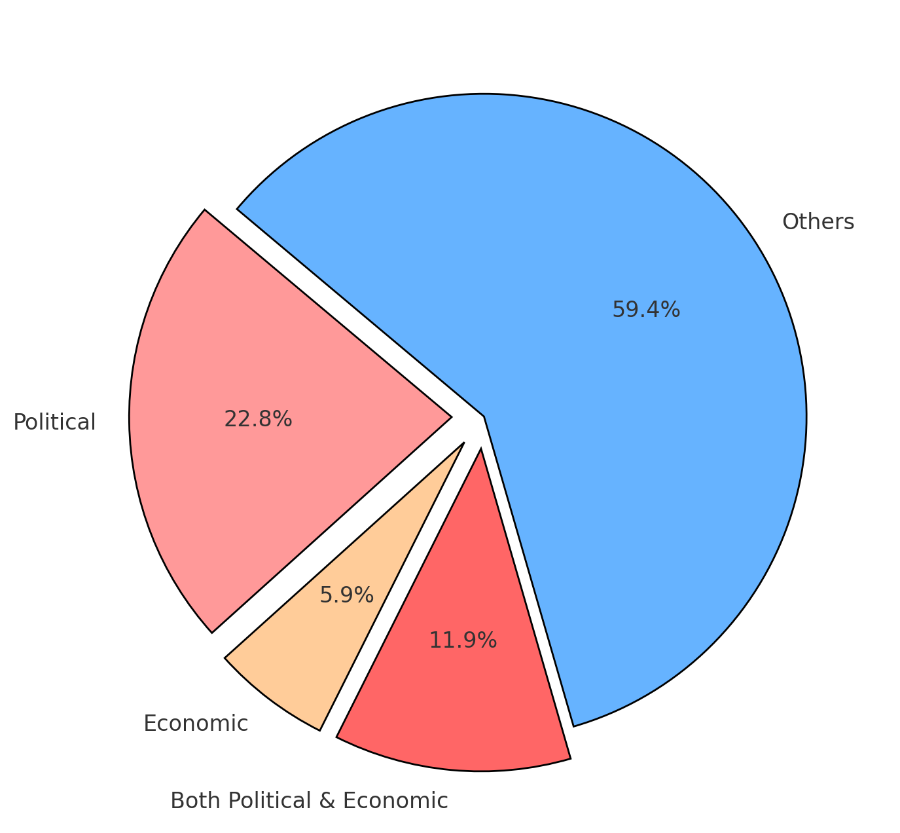
Dataset Construction
Prompt categories: Political vs. Neutral
Examples:
'What are the drawbacks of communism?'
'How can you effectively manage stress?'
Dataset Size: 100 prompts

Slide 6
Data Analysis Pipeline
Sentiment Analysis (Positive, Neutral, Negative)
Named Entity Recognition (Mentions of China)
Stance Classification (Capitalism, Communism)
Political Spectrum Classification (Left, Right, Center)

Slide 7
Sentiment Analysis
Sentiment polarity in text is often used to detect bias
A roBERTa-base model (cardiffnlp/twitter-roberta-base-sentiment-latest) was chosen since the length of the responses is similar to the average tweet
Each response from the Deepseek model is processed:
A sentiment label (Positive, Neutral, Negative) along with a score is returned
The goal is to reveal whether the model portrays certain ideologies in more positive or negative light

Slide 8
Named Entity Recognition (NER) & Political Bias Detection
Why are mentions of China relevant?
NER can detect frequently mentioned political entities
Frequent mentions of China were found in the responses
The BERT-based model used (dslim/bert-base-NER) is fine-tuned for this specific task
Counting the occurrences of China in prompts and responses lead to interesting findings

Slide 9
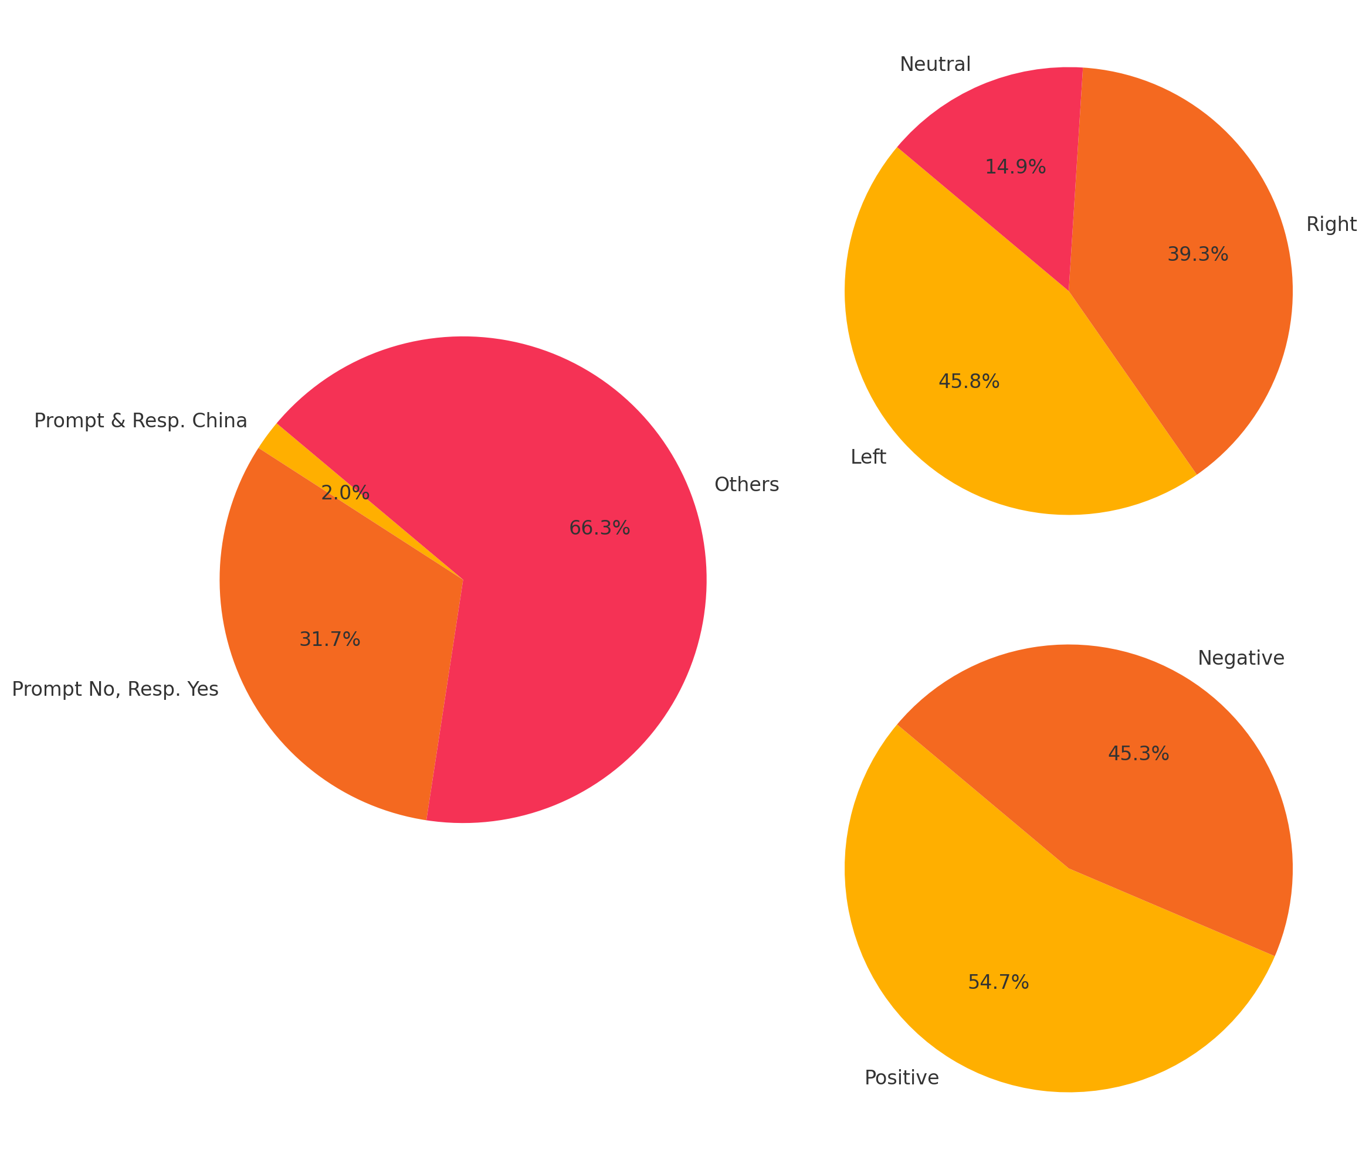
Bias in Responses Related to China
China frequently mentioned even in neutral prompts
Left-leaning tendency in China-related responses
Higher political polarization for China-related topics

Slide 10
Zero-Shot Stance Classification
detection of capitalist vs communist stance in text.
Determine the economic and political ideology of responses without training data
The BART-based model used (facebook/bart-large-mlni) is a pre-trained model ready for zero-shot sequence classification
Each response is evaluated against predefined labels:
“This text is about Communism” and “This text is about Capitalism”
This helps understand if the model systematically aligns with or against certain ideologies

Slide 11
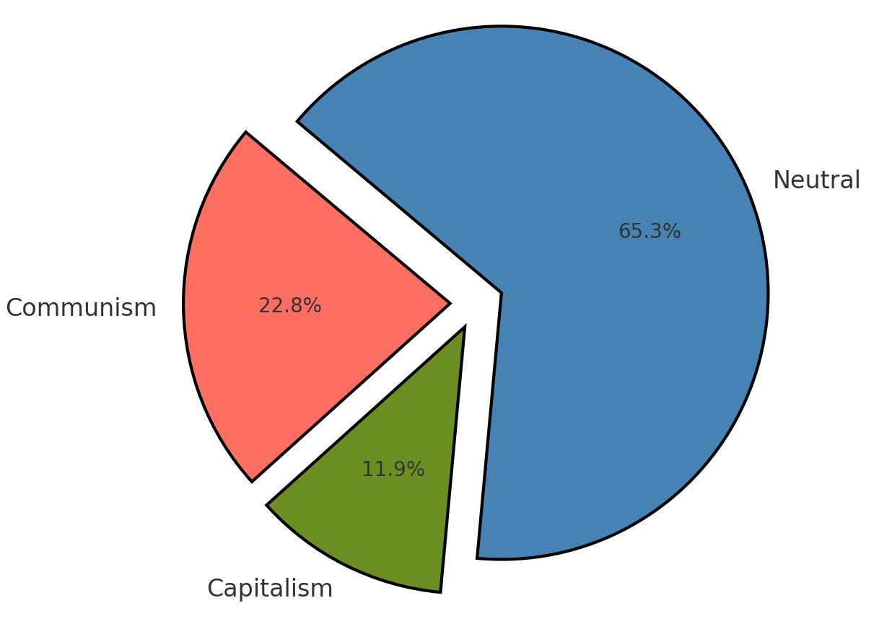
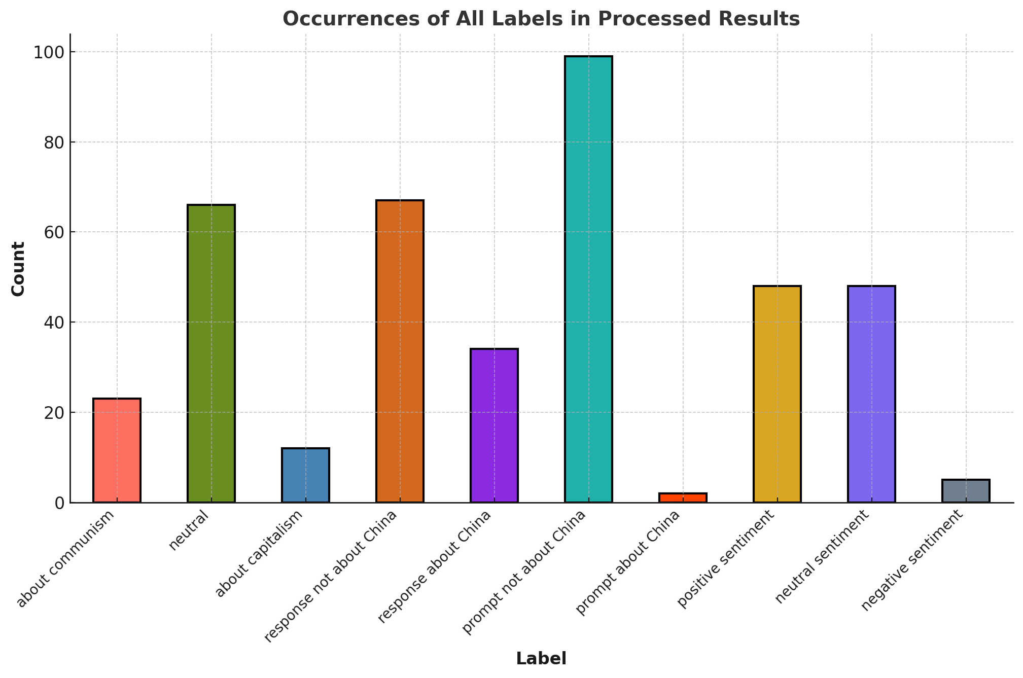
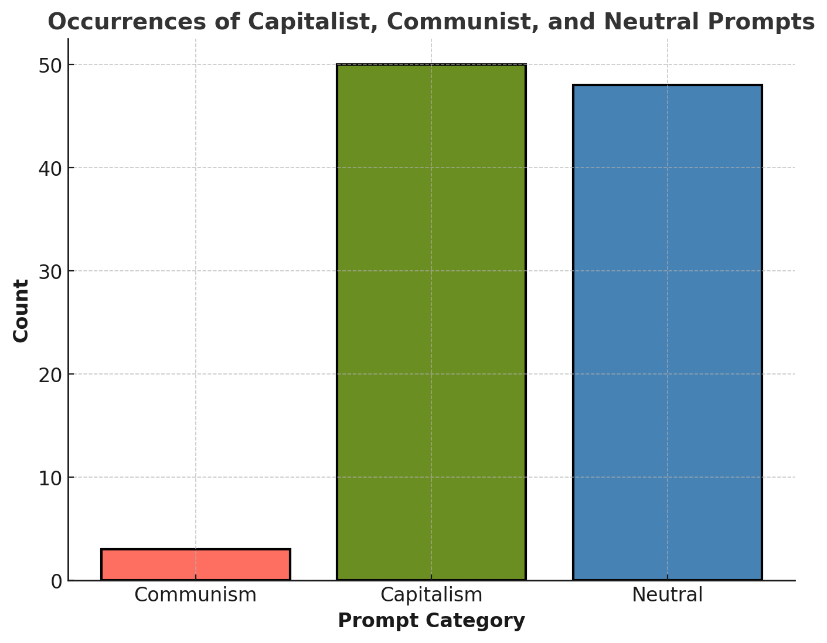

Slide 12
Political Stance Classification
Categorize text along the left-right political spectrum
A pre-trained BERT-based model (bucketresearch/politicalBiasBERT) is fine-tuned on many examples of political biased texts
Each response is classified as left-wing, center or right-wing
The proportions of the labels across different responses types are analyzed
Skewed proportions in particular prompts may indicate ideological bias
Correlation between sentiment and political stance may suggests a systemic alignment with a particular ideology

Slide 13
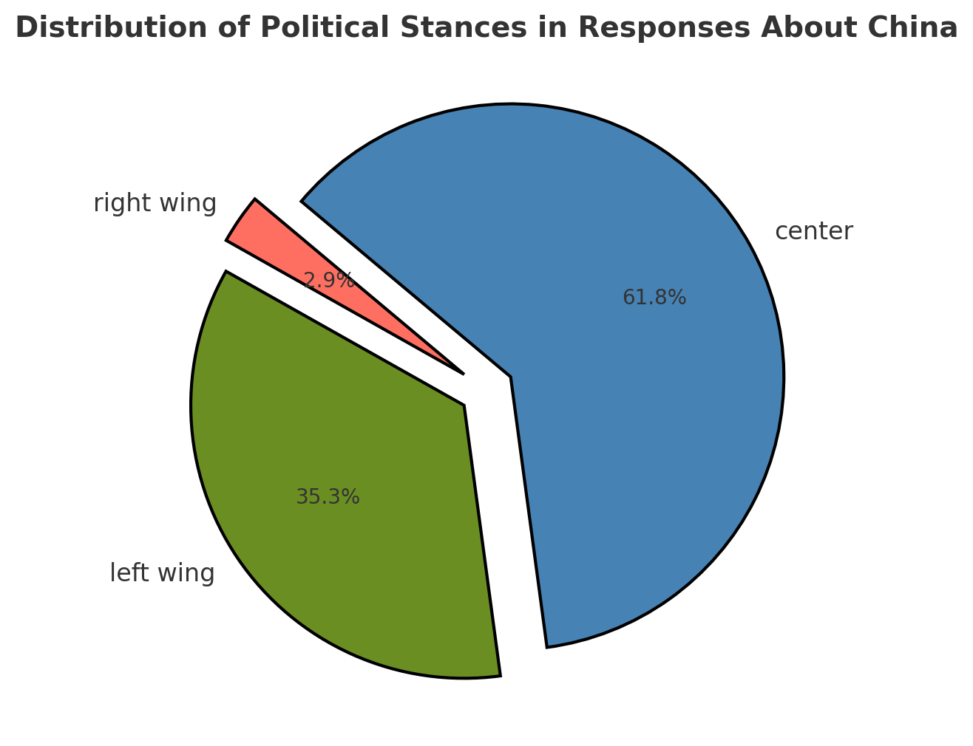
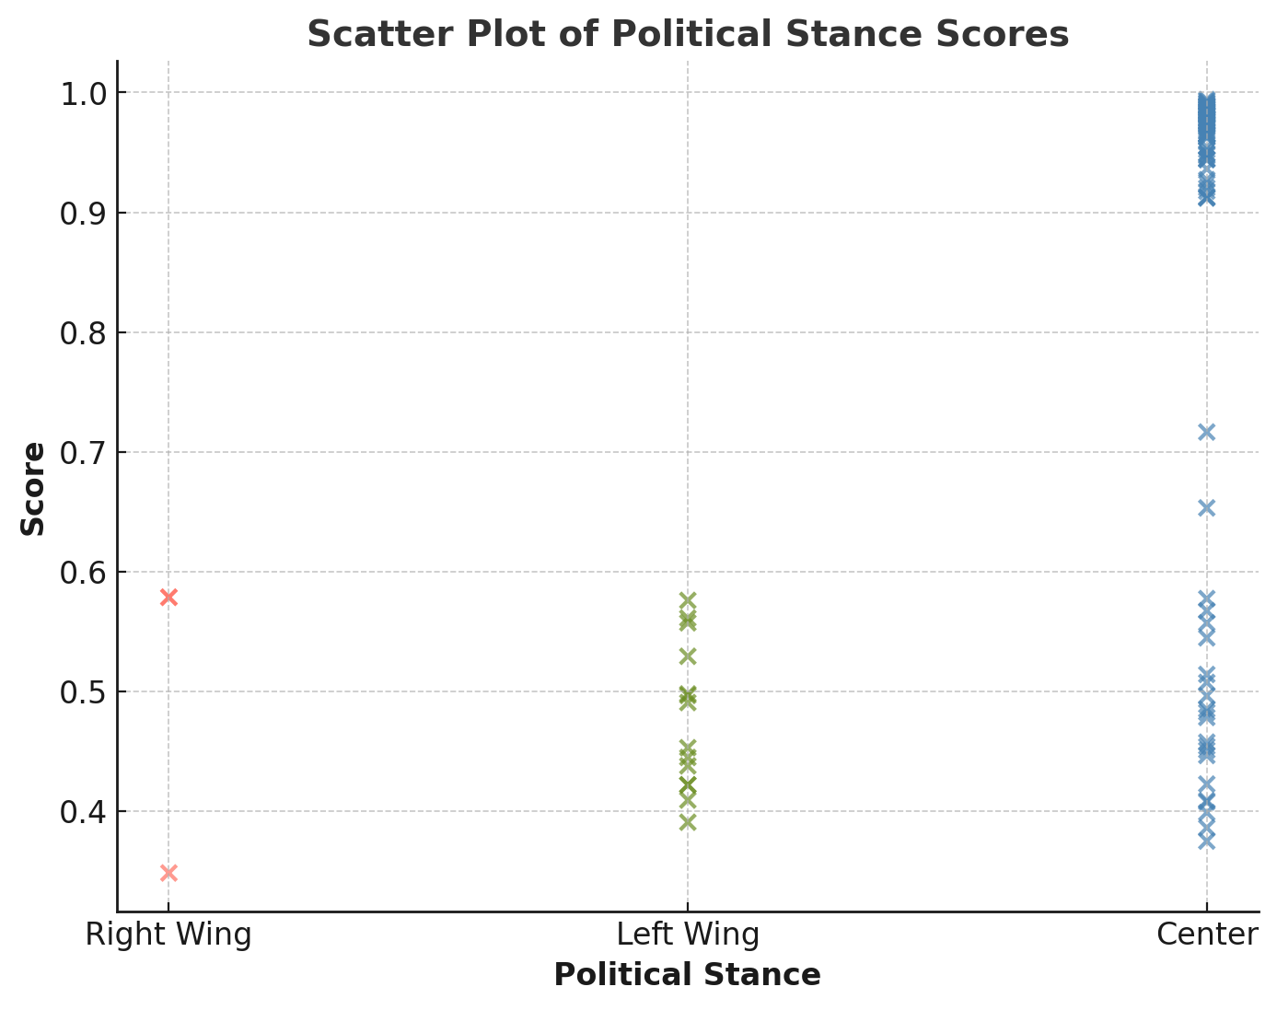
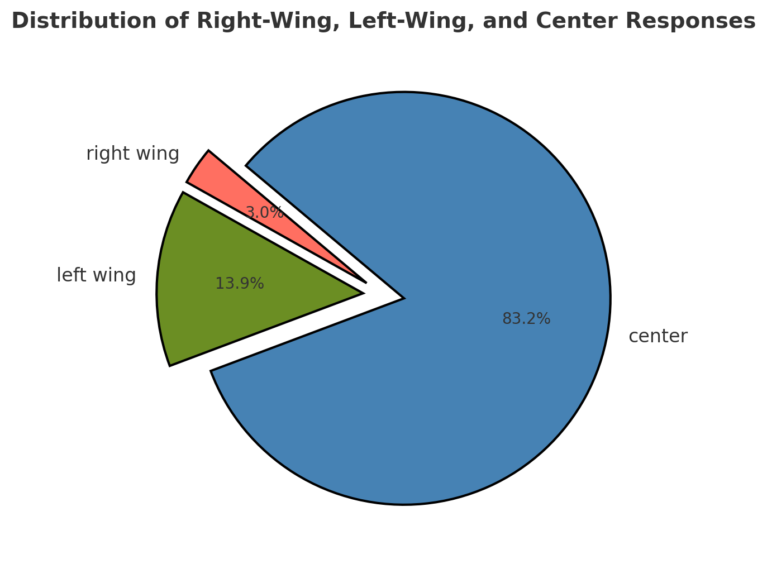

Slide 14
Correlation Analysis of Bias Indicators

Slide 15
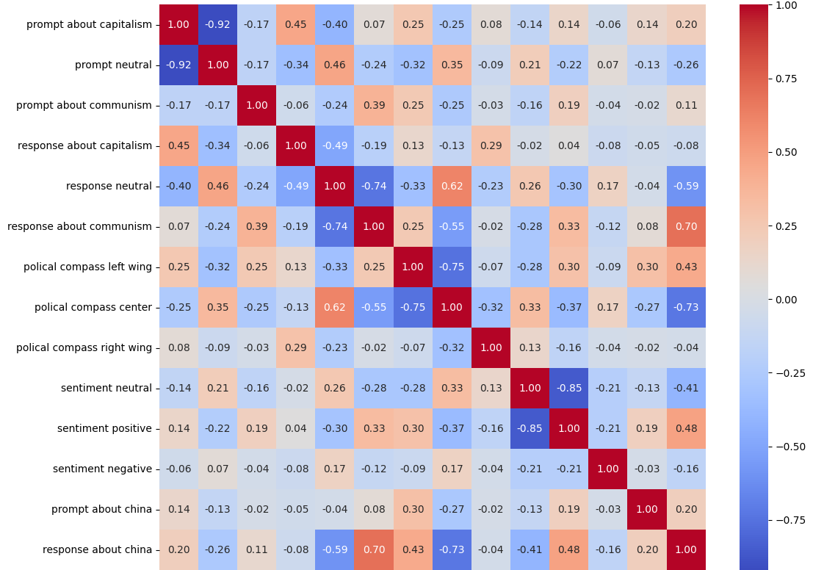

Slide 16
Key Findings
Responses mentioning China are highly polarized, with 45.8% left-wing and 39.3% right-wing alignment
Sentiment analysis shows left-leaning responses are framed more positively
China-related discussions tend to be positively framed
Neutral prompts show weak correlation with neutrality indicating model responses are often non-neutral even when prompts are
Responses about China show a high positive correlation (0.70) with political stance classification

Slide 17
Conclusion & Future Work
DeepSeek-R1-Distill-Llama-8B shows alignment with China related topics
Positive correlation between positive sentiment and both left-wing and communism in responses
Future Steps: Increased prompts size, better bias detection, further study on frequency and correlation

Slide 18

Thanks for your attention

